Slide 1





African Institute for Economic Development and Planning
59th
Session of the IDEP Governing Council
July 28, 2023
Addis Ababa, Ethiopia
Roadmaps
Evaluation 2019-2023 SF&P
Development SF&P 2024-2029

Slide 2
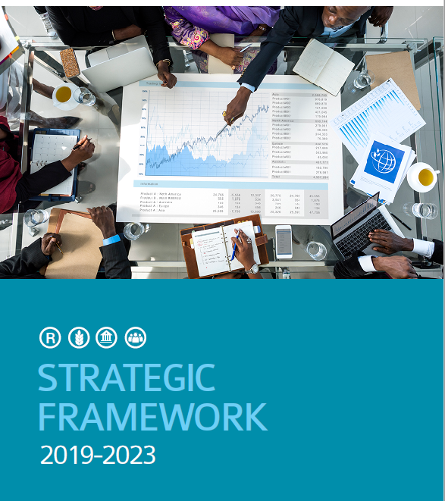
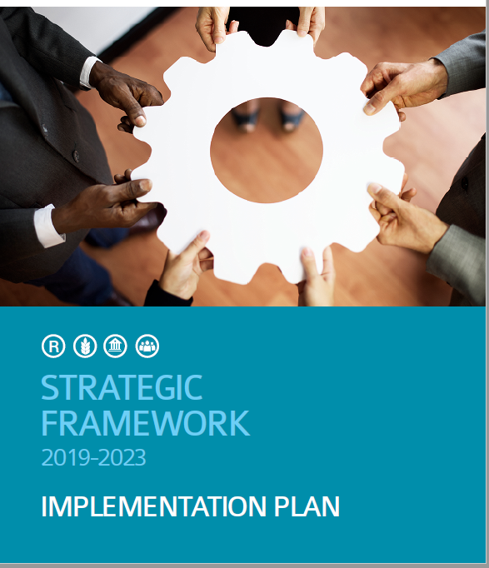

Titre ici
By 2023 : 25 African Member States are able to provide concrete evidence of improvements effected in their country in public sector management and/or development planning, with a plausible link to the knowledge, skills, and tools acquired from IDEP

Slide 3
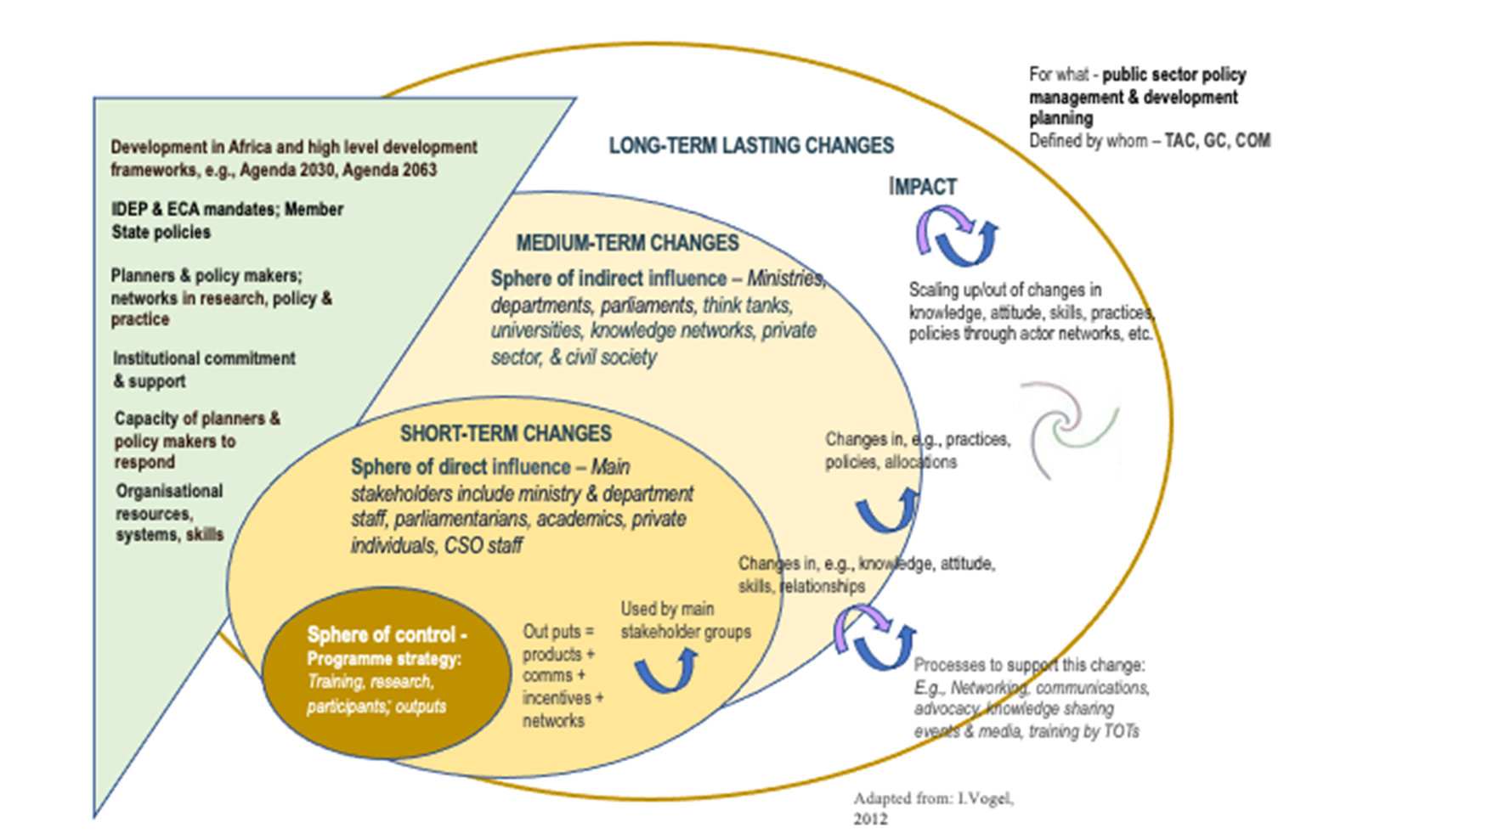

Slide 4
Highlights Results by 2023
25 African Member States are able to provide concrete evidence of improvements effected in their country in public sector management and/or development planning, with a plausible link to the knowledge, skills, and tools acquired from IDEP
70% of surveyed training alumni annually report (with evidence) they have used the knowledge skills and tools acquired from IDEP to influence policy and practice
12,000 participants trained out of which 2600 Women
5%-10% annual increase in number of requests for IDEP technical services
40,000 visits to the online library per year

Slide 5
Lead : SPORD/UNEG
Terms of Reference
Principles : Accountability, Learning & Evidence
Improved decision making
Objectives and Scope : Performance, Lessons learned,
good practices, shortfalls, opportunities for future
Stakeholders : African countries & Ambassadors & PR; Governing Council and TAC; IDEP Staff &ECA&SRO; UN secretariat & UN Agencies, Nat. sub-Reg. global institutions, Individual beneficiaries or partners; Experts & Resource persons; Alumni, etc.
Evaluation criteria : Relevance, Coherence, Effectiveness, Efficiency, Sustainability, Cross-cutting (Gender, Human Rights, disability inclusion and innovation):

Slide 6
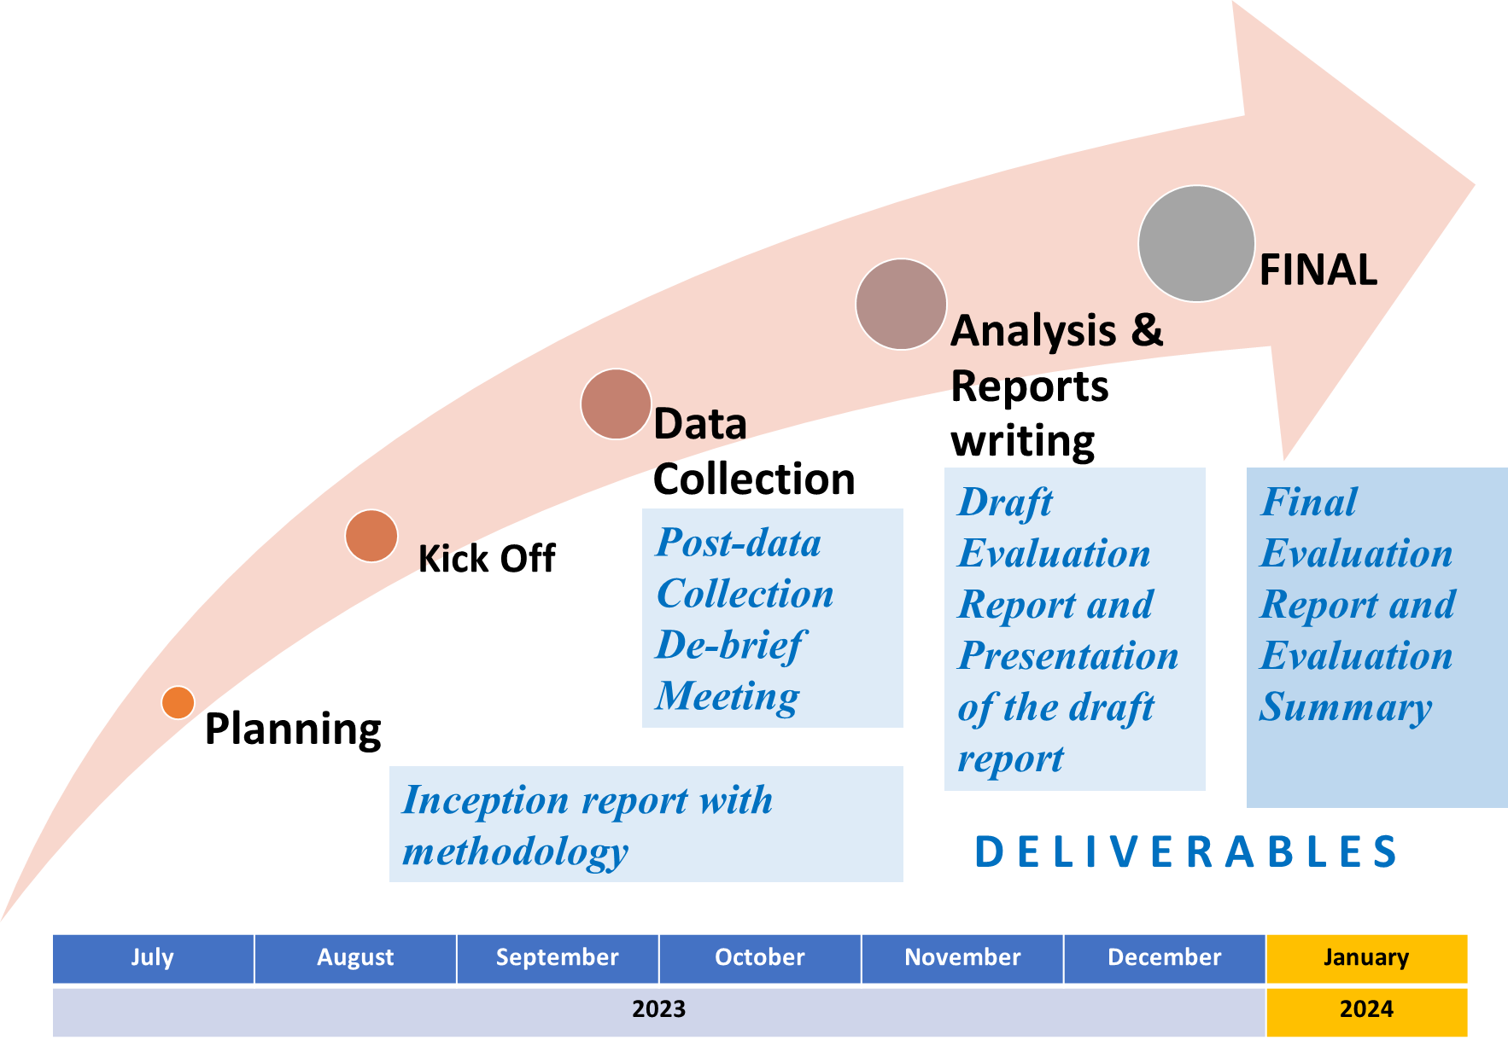
Evaluation Roadmap

Slide 7
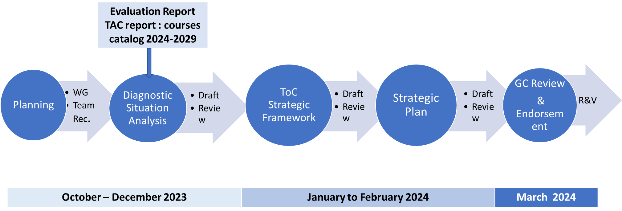
Strategic Framework 2024-2029
Roadmap

Slide 8
African Institute for Economic Development and Planning
Thank You
Merci

